Slide 1
Intro to the Piano
before reading the score

Slide 2
Objectives
play any sequence of consecutive five notes without looking at the keyboard (before learning to read the score)
read a score for both hands (after learning to read a score and before playing with both hands)

Slide 3
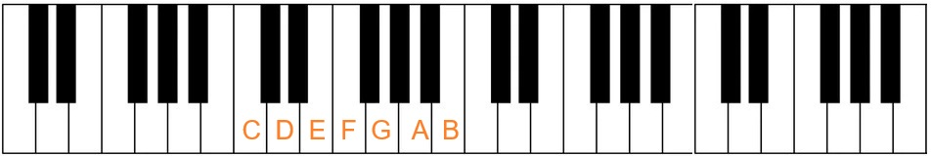
Use the black keys as a map for the white keys
use the similarity of keys with the same note to check alignment when doing the exercises with both hands

Slide 4
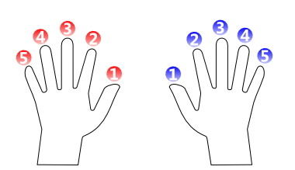
Finger numbering

Slide 5
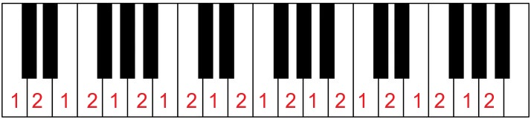
2 notes
for each hand separately
left to right and back again at the initial key
until you can do it without looking at the keyboard

Slide 6
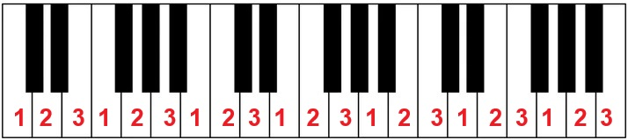
3 notes
for each hand separately
left to right and back again at the initial key
until you can do it without looking at the keyboard

Slide 7
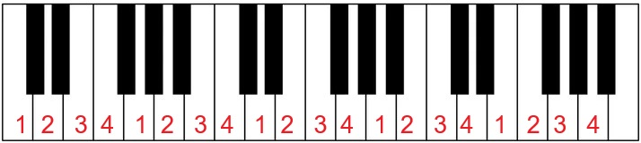
4 notes
for each hand separately
left to right and back again at the initial key
until you can do it without looking at the keyboard

Slide 8
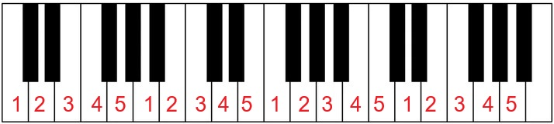
5 notes
for each hand separately
left to right and back again at the initial key
until you can do it without looking at the keyboard

Slide 9
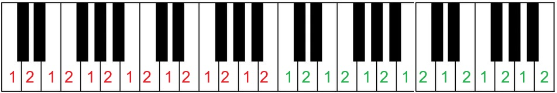
2 notes
for boths hands simultaneously
left to right and back again at the initial key
until you can do it without looking at the keyboard
you can do any number of consecutive keys on each hand

Slide 10
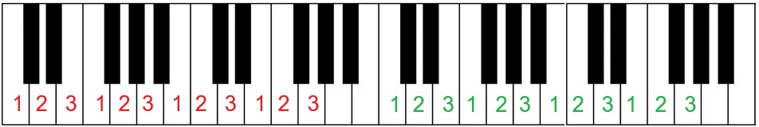
3 notes
for boths hands simultaneously
left to right and back again at the initial key
until you can do it without looking at the keyboard
you can do any number of consecutive keys on each hand

Slide 11
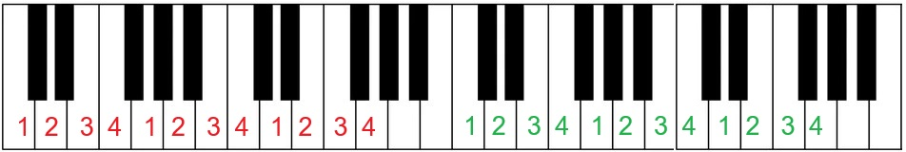
4 notes
for boths hands simultaneously
left to right and back again at the initial key
until you can do it without looking at the keyboard
you can do any number of consecutive keys on each hand

Slide 12
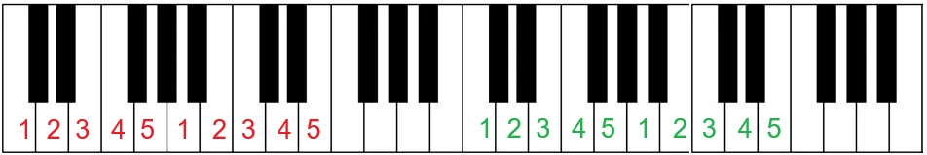
5 notes
for boths hands simultaneously
left to right and back again at the initial key
until you can do it without looking at the keyboard
you can do any number of consecutive keys on each hand

Slide 13
Coordinate hands
the previous exercises gave you a basic automation on each hand, meaning you can do basic fingerings without looking at the keyboard and without consciously thinking about it
you will need that for this exercise because you will be shifting your attention to each hand alternately while the other hand is working “on its own” (neurological fact: we do not do multitasking, we do context switching)
one hand does the same as you did on the previous exercises
the other hand, which we will call the “free hand”, does the most simple part which is always a sequence of 5 notes/fingers

Slide 14
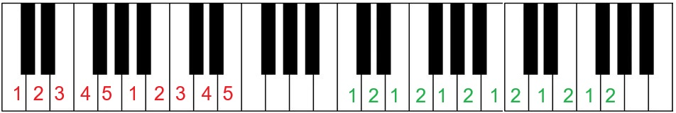
Coordinate hands – 2 notes
left to right and back again at the initial key
until you can do it without looking at the keyboard
in this example the free hand is the left
do it also with the right hand as the free hand (switch fingerings)

Slide 15
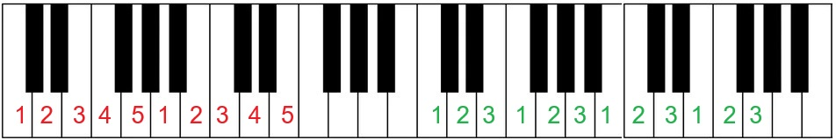
Coordinate hands – 3 notes
left to right and back again at the initial key
until you can do it without looking at the keyboard
in this example the free hand is the left
do it also with the right hand as the free hand (switch fingerings)

Slide 16
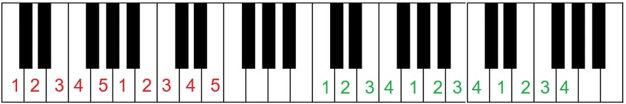
Coordinate hands – 4 notes
left to right and back again at the initial key
until you can do it without looking at the keyboard
in this example the free hand is the left
do it also with the right hand as the free hand (switch fingerings)

Slide 17
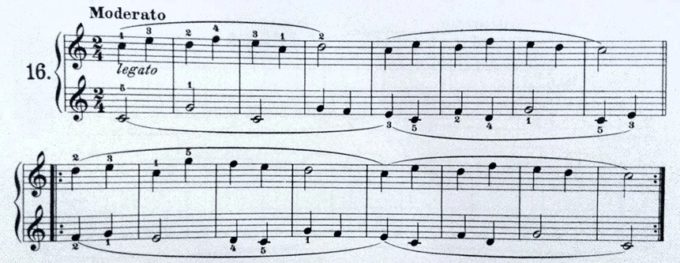
Reading the score
focus on a single simultaneous change on each hand
see how many keys/notes to shift each hand

Slide 18
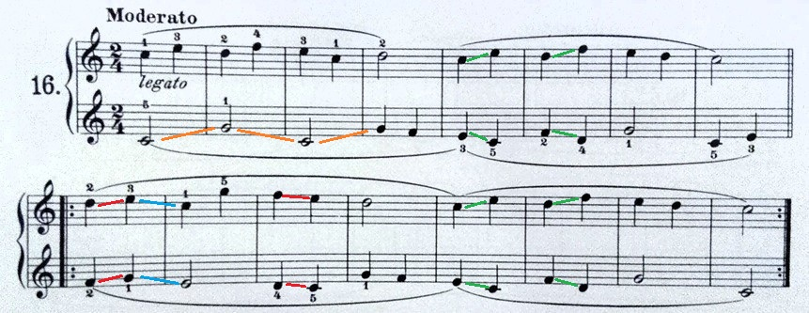
Reading the score
identify patterns

Slide 19
SOON:
How to create music using the concept of symmetry
STAY TUNED ;)

