Slide 1
Intro to the Piano
before reading the score

Slide 2
Objectives
play any sequence of consecutive five notes without looking at the keyboard (before learning to read the score)
read a score for both hands (after learning to read a score and before playing with both hands)

Slide 3
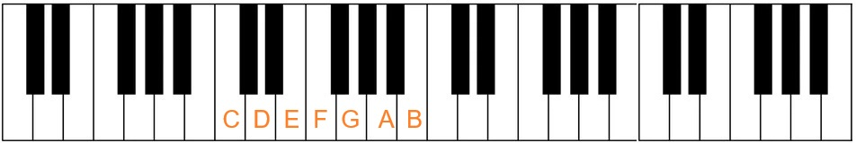
Use the black keys as a map for the white keys
use the similarity of keys with the same note to check alignment when doing the exercises with both hands

Slide 4
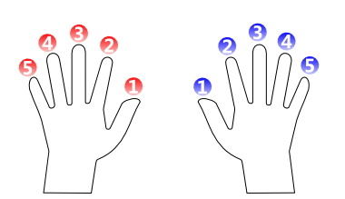
Finger numbering

Slide 5
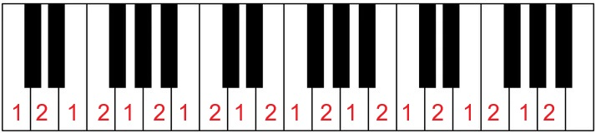
2 notes
for each hand separately
left to right and back again at the initial key
until you can do it without looking at the keyboard

Slide 6
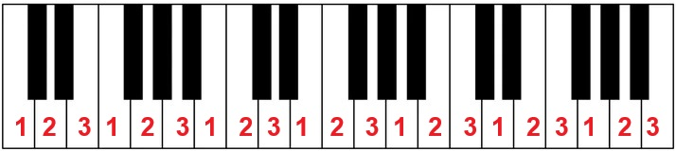
3 notes
for each hand separately
left to right and back again at the initial key
until you can do it without looking at the keyboard

Slide 7
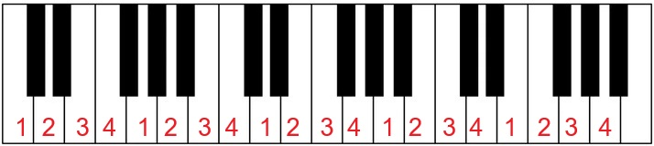
4 notes
for each hand separately
left to right and back again at the initial key
until you can do it without looking at the keyboard

Slide 8
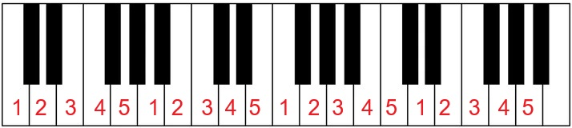
5 notes
for each hand separately
left to right and back again at the initial key
until you can do it without looking at the keyboard

Slide 9
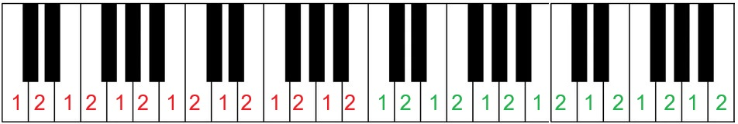
2 notes
for boths hands simultaneously
left to right and back again at the initial key
until you can do it without looking at the keyboard
you can do any number of consecutive keys on each hand

Slide 10
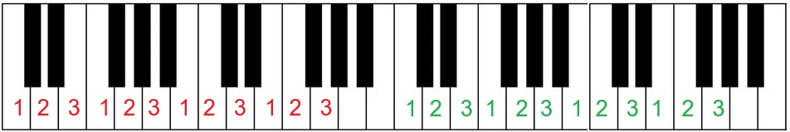
3 notes
for boths hands simultaneously
left to right and back again at the initial key
until you can do it without looking at the keyboard
you can do any number of consecutive keys on each hand

Slide 11
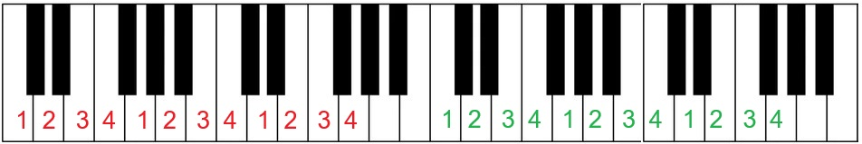
4 notes
for boths hands simultaneously
left to right and back again at the initial key
until you can do it without looking at the keyboard
you can do any number of consecutive keys on each hand

Slide 12
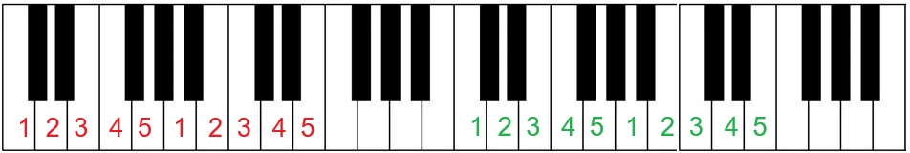
5 notes
for boths hands simultaneously
left to right and back again at the initial key
until you can do it without looking at the keyboard
you can do any number of consecutive keys on each hand

Slide 13
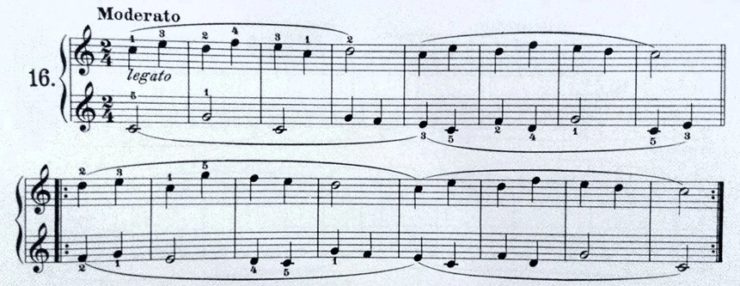
Reading the score
focus on a single simultaneous change on each hand
see how many keys/notes to shift each hand

Slide 14
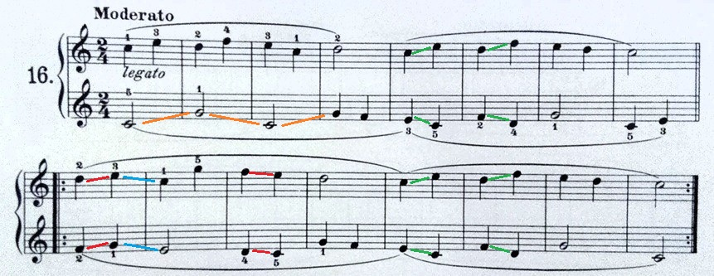
Reading the score
identify patterns

