Slide 1
new approach
for true machine reasoning

Slide 2
When he had learned enough to content him, he rose, and going to his study, brought back a recent issue of the Journal of Medieval History.
Modern researches on psychosomatic medicine, the Rhine experiments, and many other off-trail investigations, implied to any impartial philosopher the essential truth of Hamlet’s remark to Horatio:
– There are more things in heaven and earth.
adapted from The Other Side by Arthur Porges

Slide 3
Reasoning
1

Slide 4
definition of Reasoning
the sequence of arguments or proofs used to establish a conclusion by logical processes.
adapted from the American Psychological Association’s Dictionary of Psychology

Slide 5
What is the new approach?
2

Slide 6
the new approach is the first reasoning machine ever created.
the new approach demonstrates proper, scientific machine reasoning.
the new approach is the application of the model presented at August 1st 2023 to logical relationships (see References, [1]).
therefore, the new approach inherits the basic charactesristics of the previous model, namely
- proper, scientific machine learning
- performance at any scale

Slide 7
Features
the basic unit of information is an atomic proposition which is assumed to be true
atomic propositions can be combined into complex propositions using the logical connectives And, Or
propositions can be related by the logical operations of implication and equivalence (reciprocal implication)

Slide 8
Features
queries can be made to ascertain whether it is possible to prove a given set of atomic propositions assuming that another set of atomic propositions or proposition classes is true
the result of a query, if there is a solution, is a reasoning that shows how the given assumptions can be logically combined with existing information in order to derive the desired conclusions

Slide 9
a harmony of mathematical precision.
the Matrix Architect

Slide 10
What the new approach proves
3

Slide 11
the new approach proves that both the pillars of proper, scientific artificial intelligence were accomplished:
proper, scientific machine learning
proper, scientific machine reasoning

Slide 12
the end

Slide 13
REFERENCES
[1] New Approach for True Machine Learning, Mário Vicente, August 1st 2023
[2] Presentation template by Slides Carnival

Slide 14
ADDITIONAL INFORMATION
this presentation was made public at March 7th 2025 and this fact is to be considered for any related patent proposals
the new approach is not a comercial designation
this presentation is not comercial and does not feature a comercial product or service, currently or future
a proof of concept demonstration can be provided upon request

Slide 15
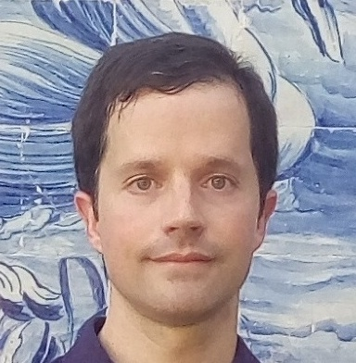
Author
Mário Vicente
you can find me at
https://mariovicente.ltd
contact@mariovicente.ltd

