Slide 1
A new approach
for true machine learning

Slide 2
Before him stood a boy, most strange and wild in aspect, with black tangled hair, and dark, burning eyes. An amazingly handsome, perfect face.
In a sonorous voice, suggestive of the melodious outpouring of a stringed instrument, he spoke:
– We had planned a great, terrible affair, that our names might be honoured by future generations.
adapted from The Invoker of the Beast by Feodor Sologub

Slide 3
Learning
1

Slide 4
definition of Learning
the acquisition of novel information by organizing it into a coherent representation and integrating it with existing information, and evidenced by change in behavior.
adapted from the American Psychological Association’s Dictionary of Psychology

Slide 5
features of Learning
New information integrity is preserved
Existing information is coherent
New information is integrated with the existing information
Learning translates to behavior change

Slide 6
consequences of the definition
Behavior change is simultaneous with the acquisition of new information
Pre-existing information is preserved
Behavior is provable

Slide 7
What is the new approach?
2

Slide 8
The new approach is the first learning machine ever created.
The new approach is both a novel structure of information and a novel way of using information.
The new approach is the proof of feasibility of long sought concepts in artificial intelligence

Slide 9
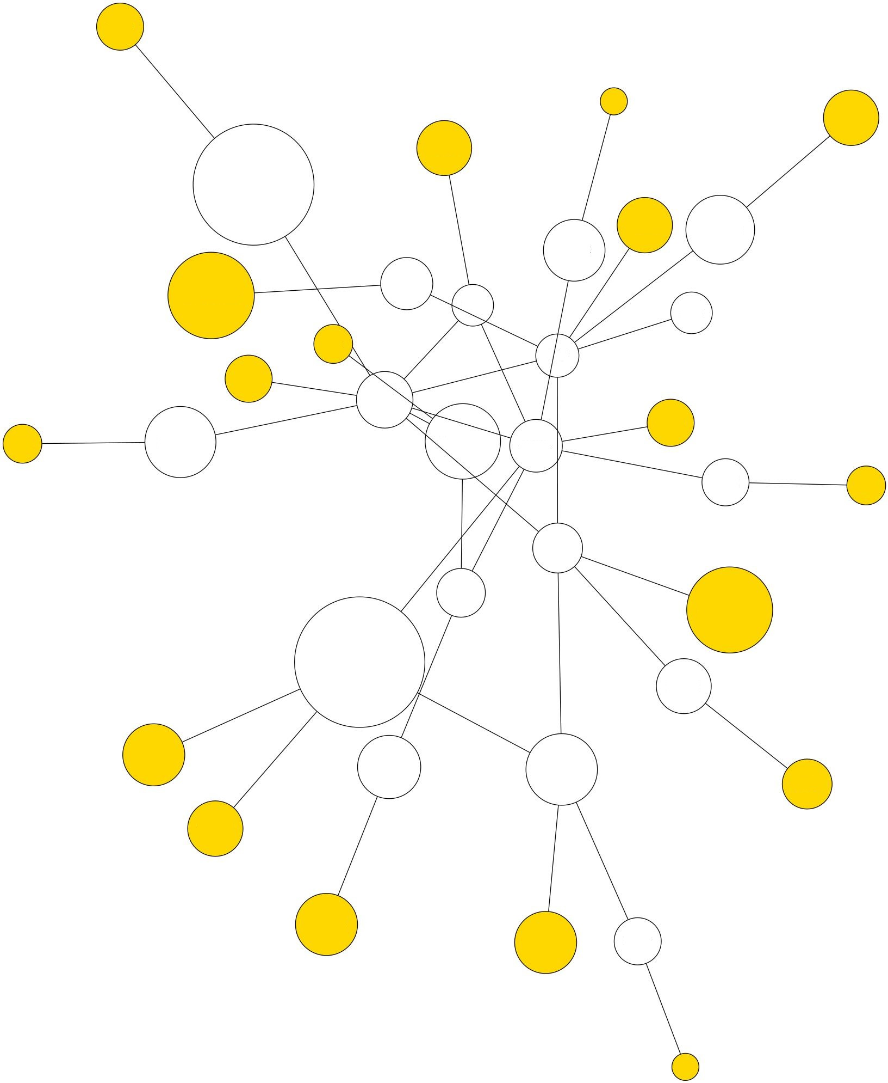
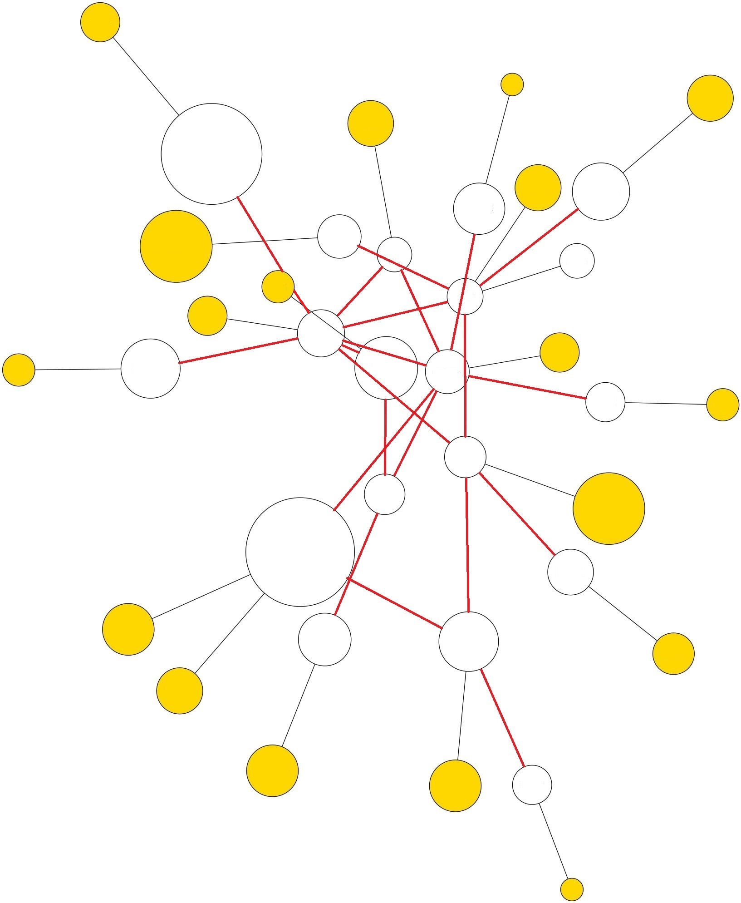
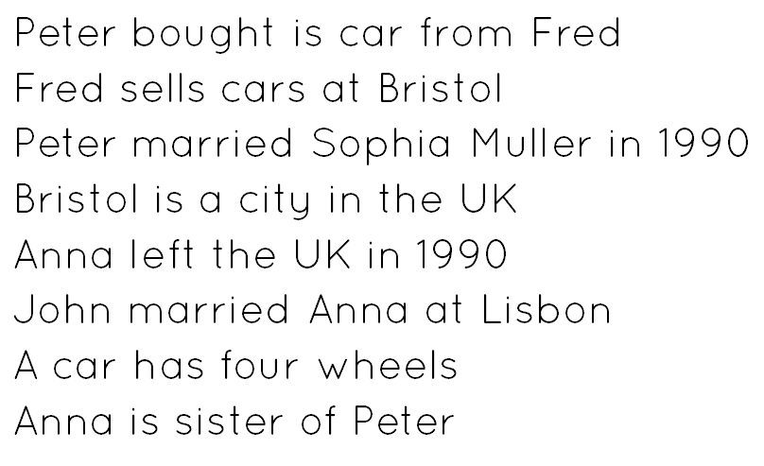
Features
Processing is determined by geometric features and these in turn are determined by the information itself
data
structure
processing

Slide 10
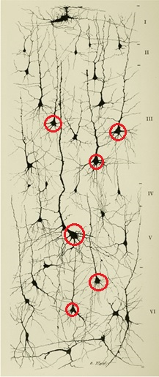
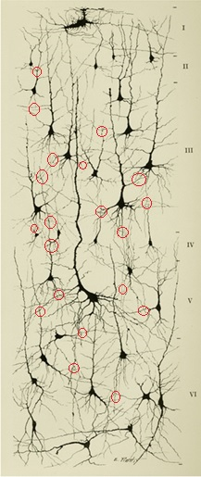
Features
Processing occurs at the relationship level
classical
neural
networks
new
approach

Slide 11
Features
Therefore, there is no distinction between data and processing units.

Slide 12
Form and function are a unity, two sides of one coin.
Ida Pauline Wolf

Slide 13

Features
Simple mathematical computations with a geometric meaning

Slide 14
Simplicity is the ultimate sophistication.
Leonardo da Vinci

Slide 15
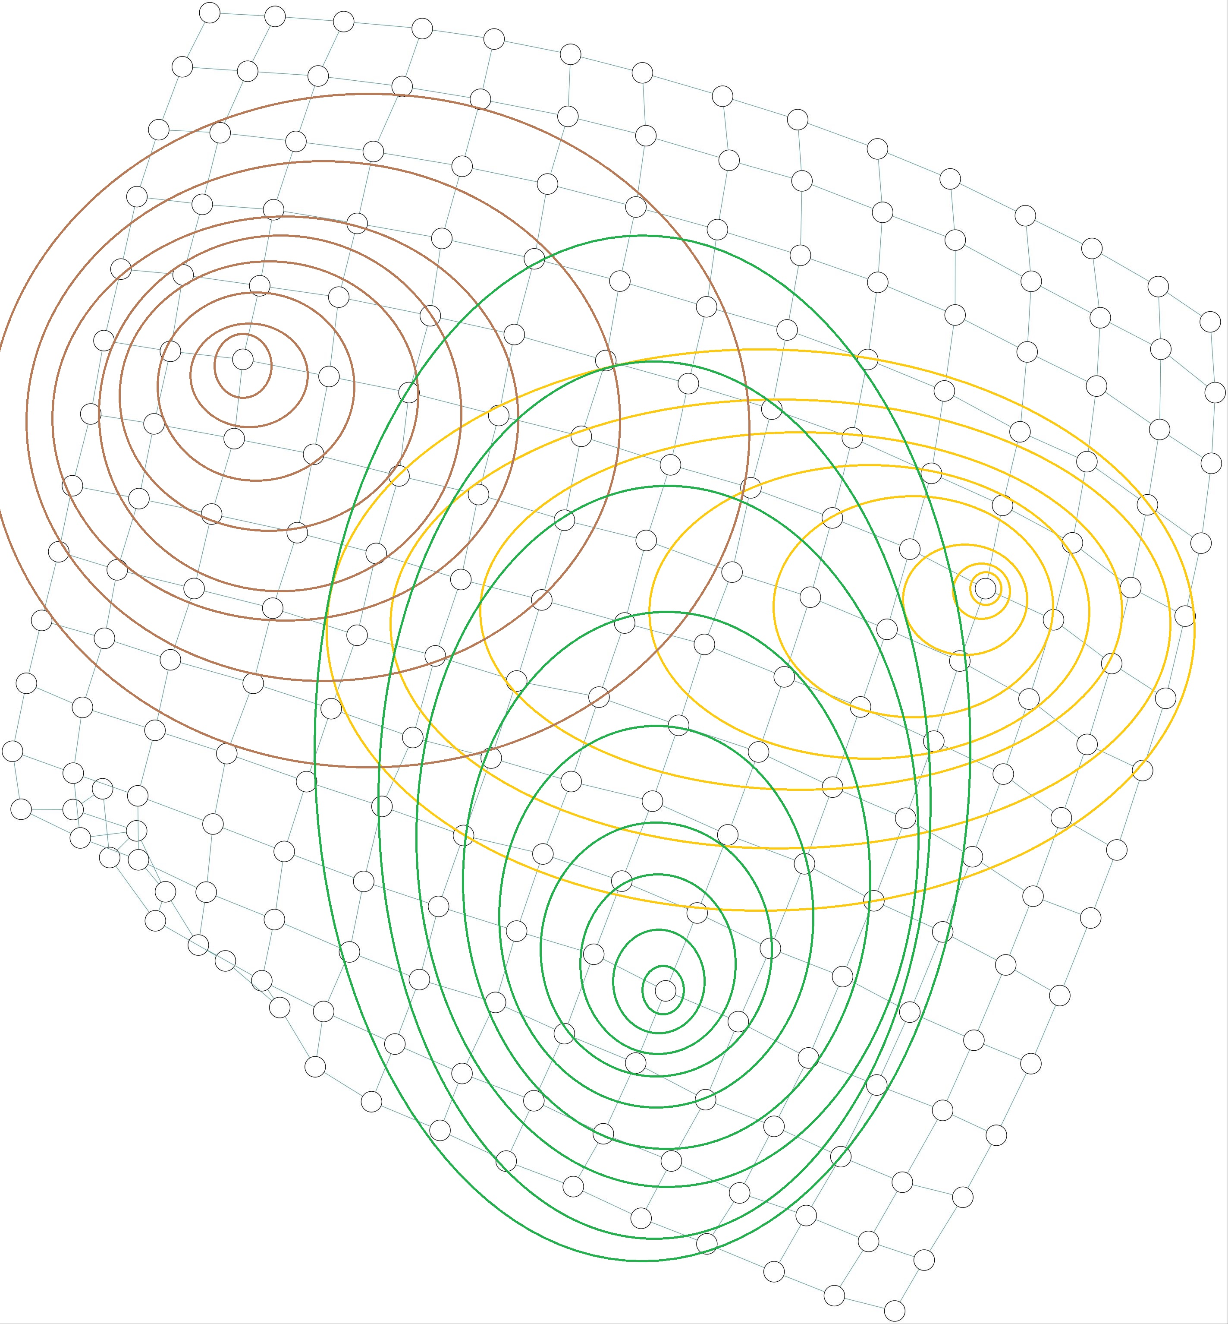
Features
Natively scalable by parallelization

Slide 16
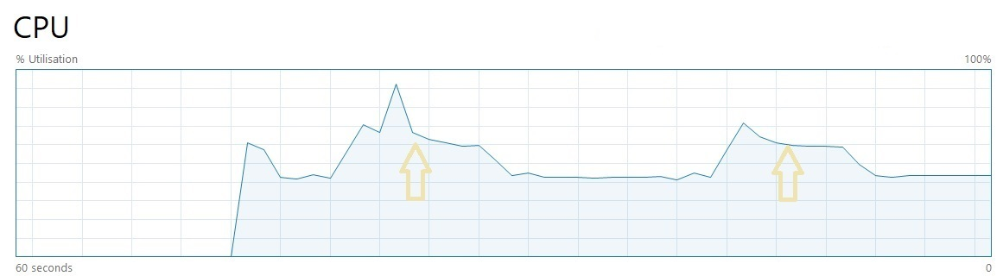
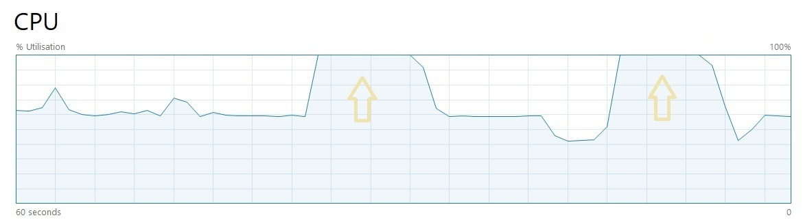
Search iterations without parallel processing
Search iterations with parallel processing

Slide 17
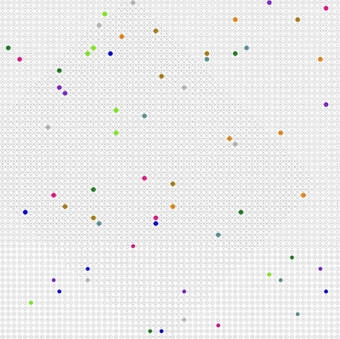
Features
Any number of geometric units interact with each other in parallel and real-time

Slide 18
Features
The system state includes only the learned information, no parameters whatsoever
Any request is handled from scratch
No prior conditioning is needed to perform
Therefore no bias is built in the model
Learning happens on-the-fly
Any response fitness is humanly provable

Slide 19
What the new approach proves
3

Slide 20
The new approach proves that it is possible to build systems that learn like we do.
The new approach proves that it is possible to build systems whose intelligence matches our own, because reasoning is learning driven by the system itself.
The new approach proves that the gap to AGI is not the complexity of computing but merely its parallelization.

Slide 21
The road ahead
4

Slide 22
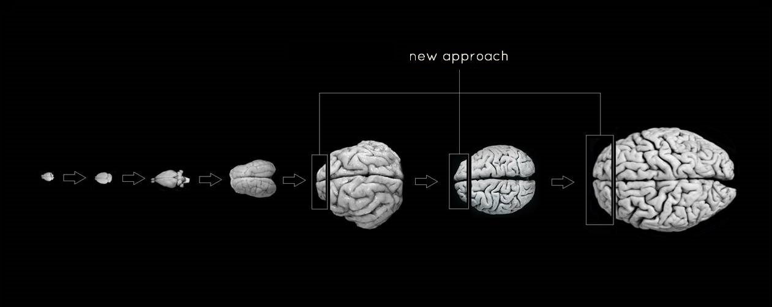
phylogenetics of AI
enabling learning and reasoning – beyond data mapping and static trained models of current AI
rational control over current AI capabilities

Slide 23
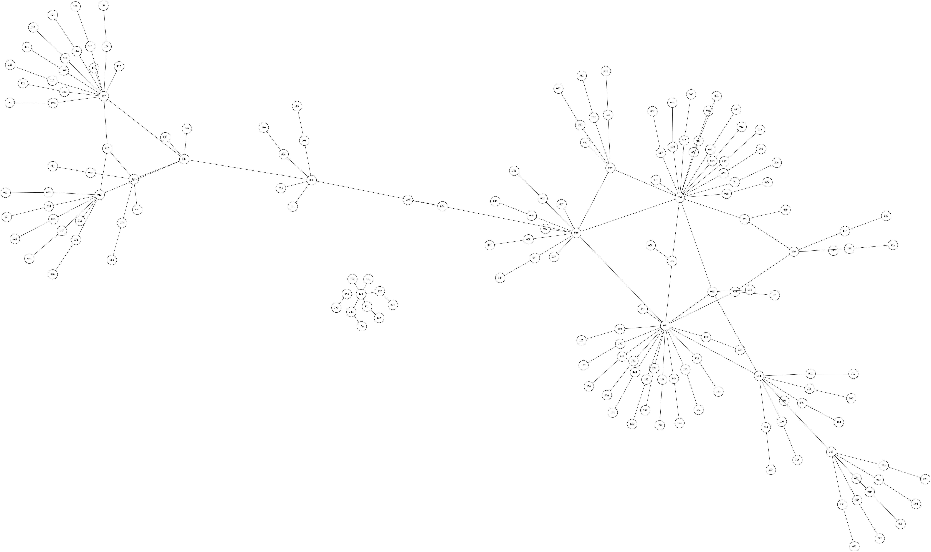
processor architectures designed for AI

Slide 24
All great things have small begginings.
Peter Senge

Slide 25
the end

Slide 26
CREDITS
Neuroanatomical images by Frontiers in Neuroanatomy, www.frontiersin.org
Presentation template by Slides Carnival
Background music:
  ambient piano - by blackpybeats

Slide 27
ADDITIONAL INFORMATION
This presentation was made public at August 1st 2023 and this fact is to be considered for any related patent proposals
The new approach is not a comercial designation
This presentation is not comercial and does not feature a comercial product or service, currently or future
A proof of concept demonstration can be provided upon request

Slide 28

Author
Mário Vicente
you can find me at
https://mariovicente.ltd
contact@mariovicente.ltd

